Slide 1
GIS Data in PDS4
Trent Hare and Lisa Gaddis
(and Cartography and Imaging Node)

Slide 2
GOALS
Problem: Currently missions are forced to host GIS data formats within “misc” or “extras” archival directories
Data in existing archives: image footprints, Lunar mare boundaries, Titan channels, Apollo 17 traverse lines, and layers which comprise of a geologic map (linear structure and geologic polygonal boundary units)
Proposal: Allow for archival of GIS data as a simple variable width ASCII PDS4 table, including a geometry string
Notes:
The PDS has long been in need to support Geographic Information System (GIS) vector (point, line, and polygon) style of format. Currently several missions and funded projects are left to archive such data types within “miscellaneous” or “extras” archival directories. Many of these files are not discoverable or contain the appropriate metadata as provided by with a proper PDS4 label. Data which have been unofficially archived in this manner include: image footprints, Lunar mare boundaries, Titan channels, Apollo 17 traverse lines, and layers which comprise of a geologic map (linear structure and geologic polygonal boundary units). Here we introduce a method which builds upon PDS4’s approved variable width ASCII table support.

Slide 3
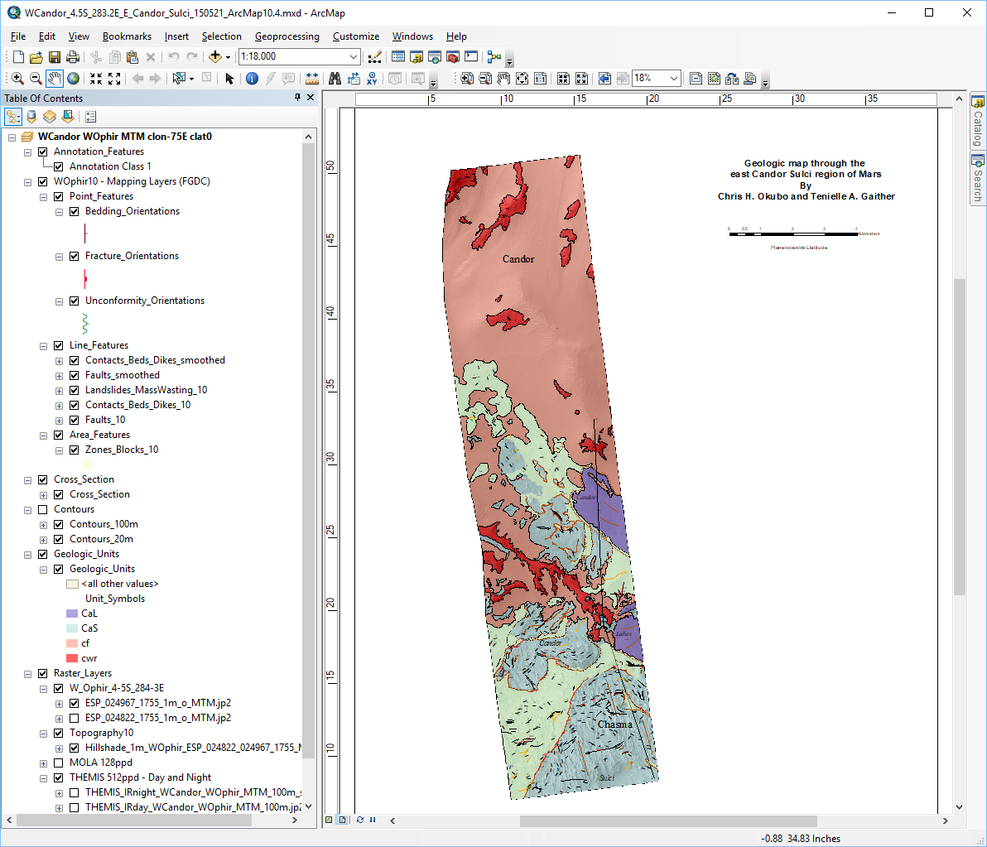
Use case: Geologic Map to PDS4
Geologic map through the east Condor Sulci region of Mars
by
Chris H. Okubo and
Tenielle A. Gather

Slide 4
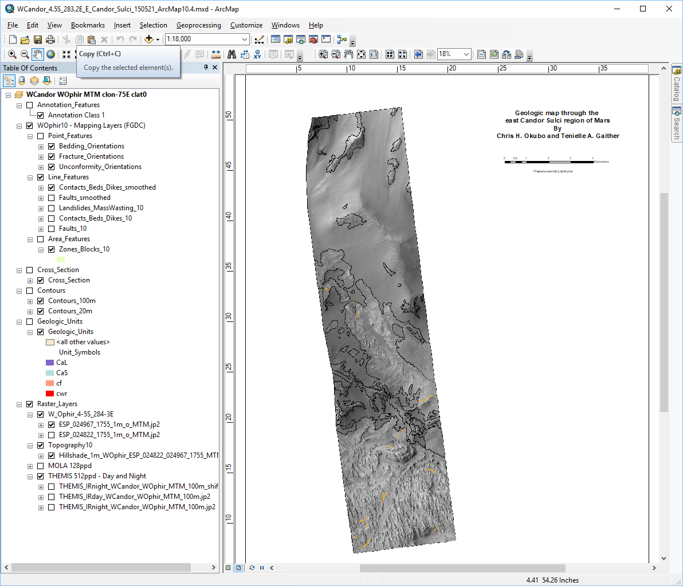
setting the stage
Contacts
  attributed lines

Slide 5
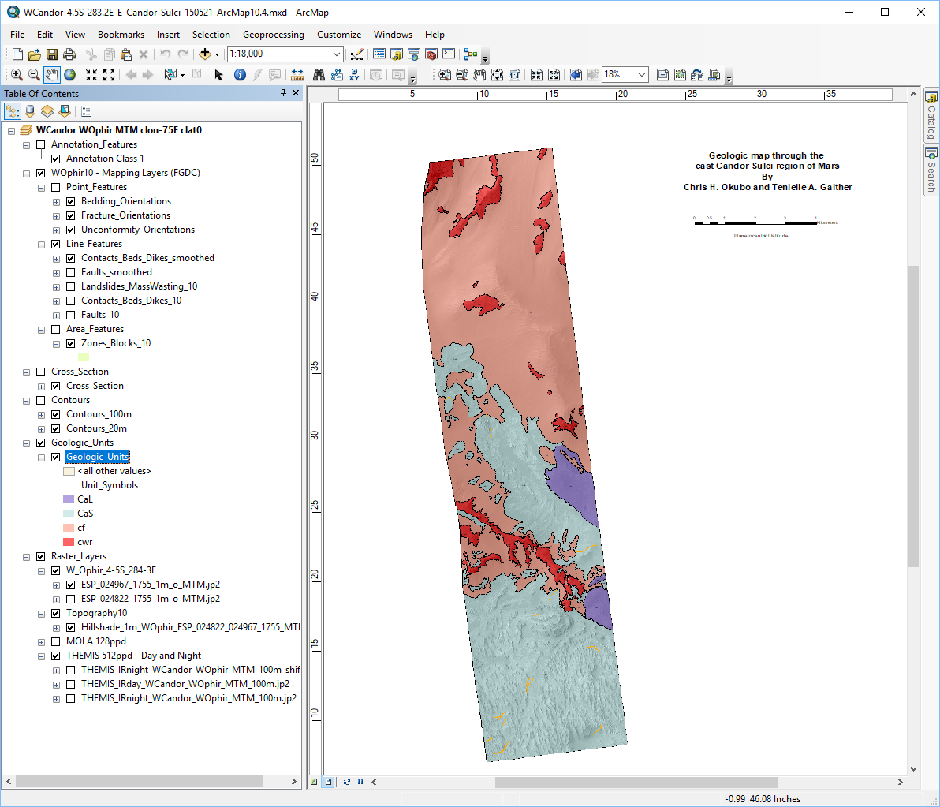
setting the stage
geologic units
  poylgons

Slide 6
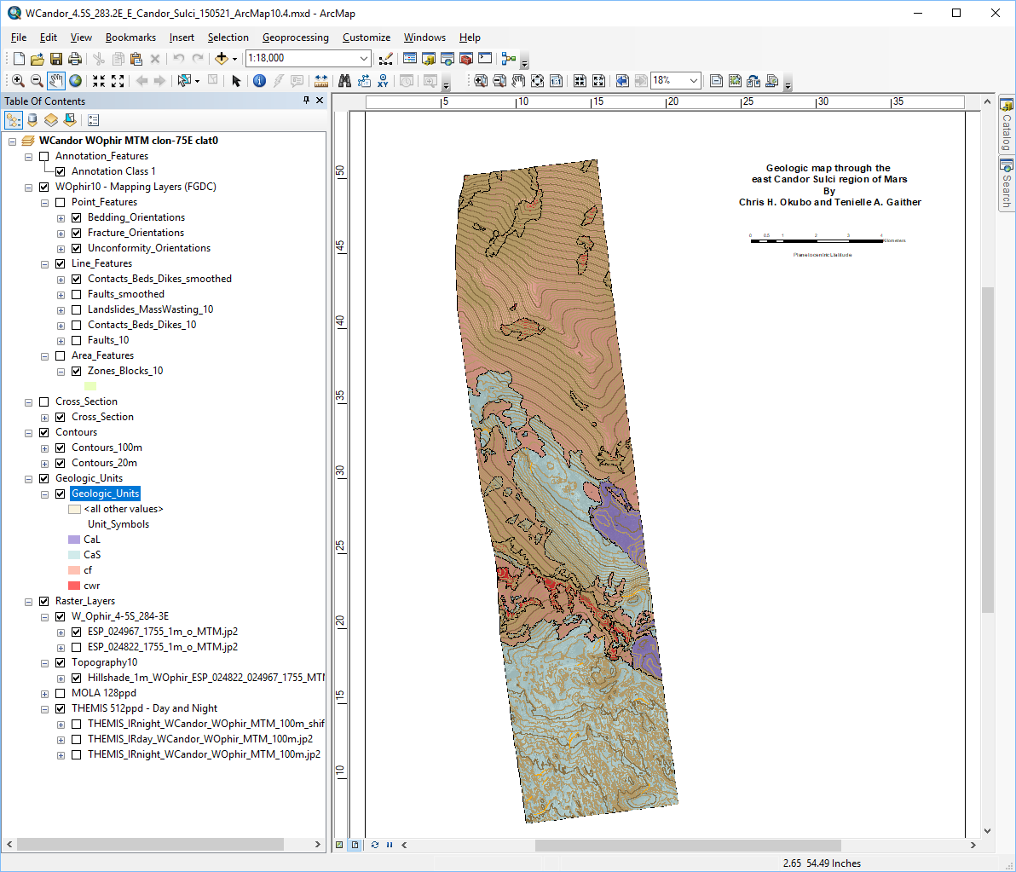
setting the stage
contours

Slide 7
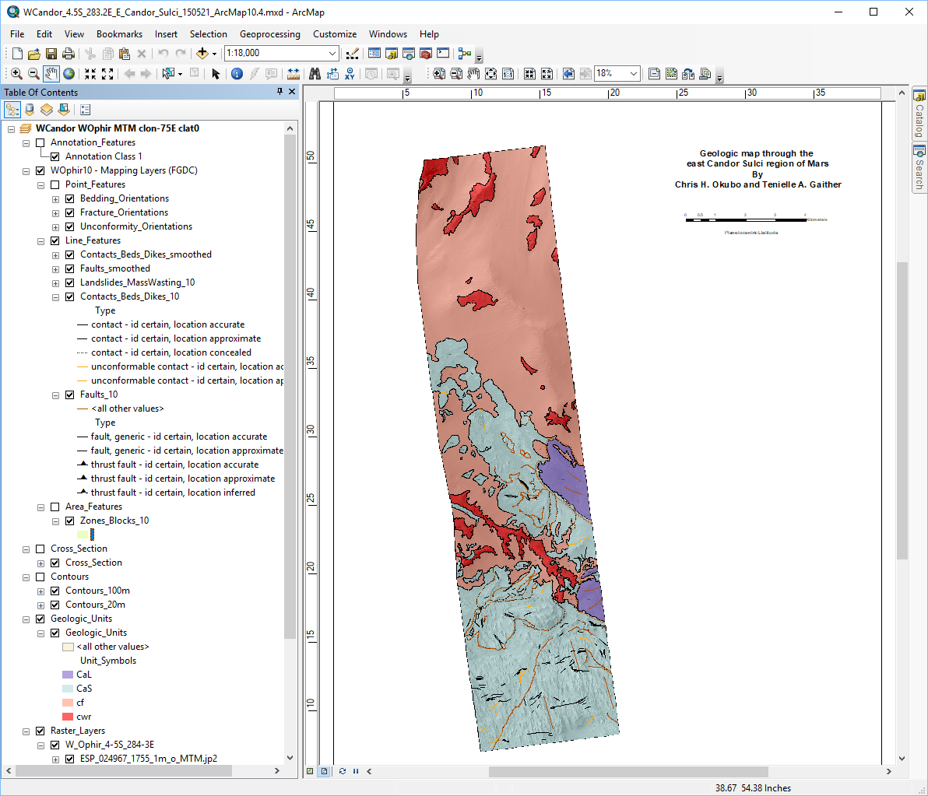
setting the stage
attributed lines
also shows geologic
standardized symbols

Slide 8
setting the stage
attributed points
w/ rotations
also shows geologic
standardized symbols

Slide 9
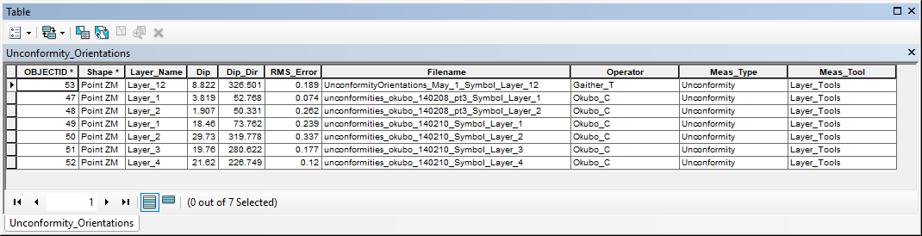
Issues to address – vector attributes
Each feature can have many attributes. Okay, map to CSV table.

Slide 10
Issues to address – vector geometries (points, lines, polygons)
Points could be a PDS4 table with rotation field
Each line could be a PDS4 table with Lon,Lat columns building the line. But with 100 to 1000 features per layer, this becomes unreasonable. Also some lines can have multiple parts. For example, this is really one feature:
Polygons could represented as PDS4 table but there is no support for multiple parts or holes.

Slide 11
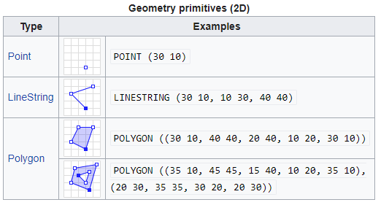
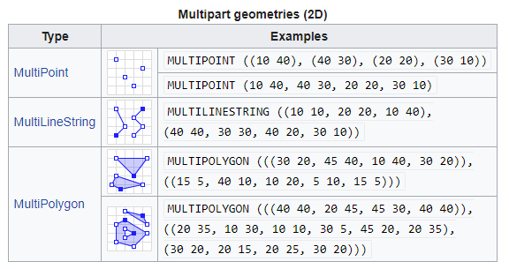
vector geometries (points, lines, polygons)
Well-known text (WKT) is a text markup language for representing vector geometry
Defined in International Organization for Standardization (ISO) standard 19125 specifies a common storage and access model of mostly two-dimensional geometries (point, line, polygon, multi-point, multi-line, etc.) used by geographic information systems.

Slide 12
vector symbologies
Currently NOT going to tackle. Possible solution for future:
GML or GeoPDF

Slide 13
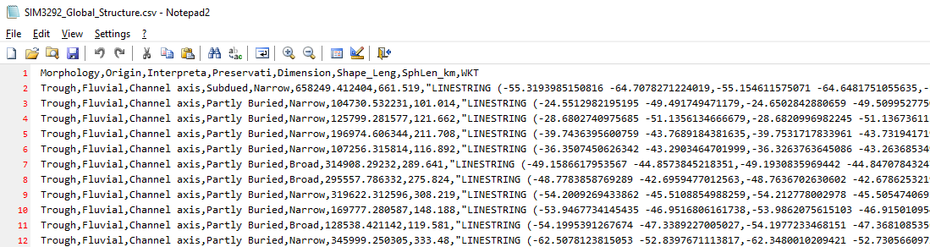
Recommended path forward: GeoCSV
(slight variation on)
Simple CSV table with a WKT geometry as the last column.

Slide 14
Adding PDS4 table driver in GDAL
GDAL = Geospatial Data Abstraction Library
  Supports 150+ raster formats
    Basic support for PDS3, PDS4, VICAR, ISIS2, ISIS3, FITS (soon GeoFITS)
  Supports 50+ vector/table formats (including databases)
    Sqlite, Oracle, MySQL, PostGRES, MSSQL, etc.
  High-level language support (e.g. Python, JAVA, etc.)

Slide 15
Adding PDS4 table driver in GDAL
Table driver should be available in January (contract to Hobu Inc.)
  Support for general PDS4 table read/write/conversion (ASCII or binary)
  Support for “GIS” geospatial tables (GeoCSV)
  Support for label creation focusing on table structure and cartography
Beta PDS4 raster driver (read/write) already available
  Relies on PDS4 templates (as generated from PLAID, OPUS, etc.)
  Supports Cartography section

